Slide 1
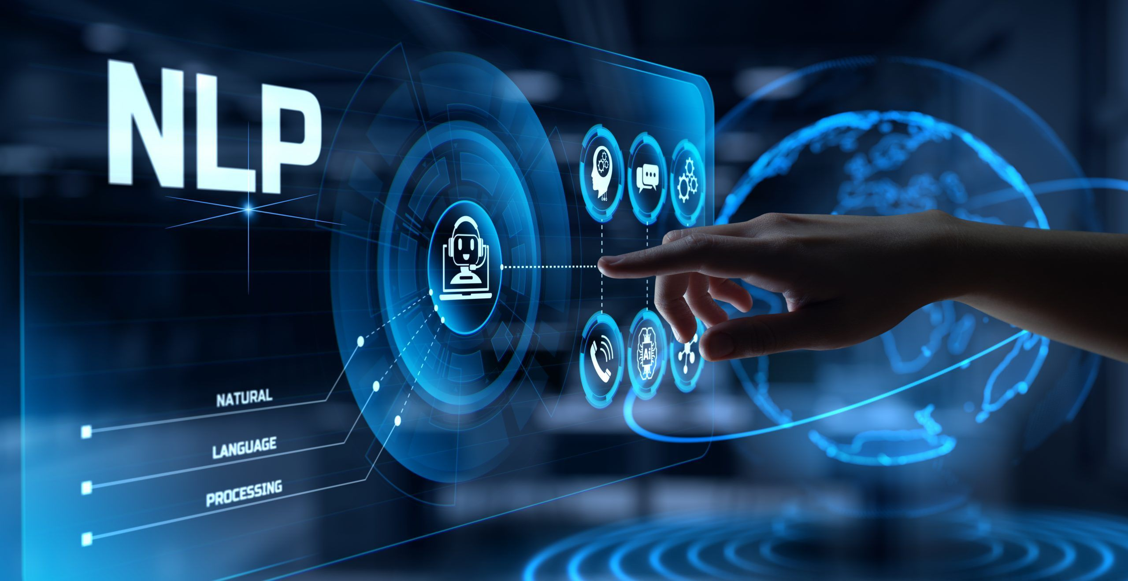
Presentation by ;
MOHAMMAD ASIF
MADAN KUMAR

Slide 2
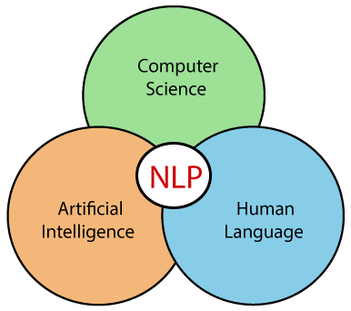
Natural language processing (nlp)
Natural Language Processing is a
field that combines computer science,
artificial intelligence and Human language.
It helps computers understand, process and
create human language in a way that makes
sense and is useful.

Slide 3
Importance of natural language processing
1. Communication with Computers
NLP allows humans to interact with computers in their natural language, making technology more accessible and user-friendly.
2. Information Extraction and Analysis
NLP helps in extracting valuable information from large volumes of unstructured data, such as social media posts, emails, and news articles.

Slide 4
3. Automation and Efficiency
Chatbots and virtual assistants provide instant responses to customer queries, improving service efficiency.
4. Language Translation
Tools like Google Translate use NLP to break down language barriers, enabling communication across different languages and cultures.
5. Security and Fraud Detection
Email systems use NLP to detect and filter out spam messages.
NLP helps in identifying fraudulent activities by analyzing patterns in textual data.

Slide 5
Components of natural language processing
Natural language understanding (NLU)
NLU helps machines understand and analyze human language by extracting keywords, emotions, relationships, and semantics from large amounts of text.
Natural language generation (NLG)
NLG helps in generating the output in a natural language based on the input provided by the user.

Slide 6
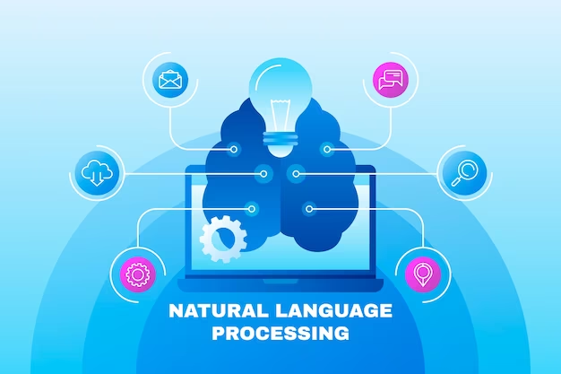
Steps in natural language processing
Lexical analysis
Syntactic analysis
Semantic analysis
Discourse integration
Pragmatic analysis

Slide 7
1.Lexical analysis
It focuses on identifying and processing words in a text. It breaks down the input text into individual tokens that are meaningful units of language such as words or phrases
2. Syntactic Analysis
Syntactic Analysis helps in understanding how words in a sentence are arranged according to grammar rules. It ensures that the sentence follows correct grammar which makes the meaning clearer.
3. Semantic Analysis
Semantic Analysis focuses on understanding meaning behind words and sentences. It ensures that the text is not only grammatically correct but also logically correct.

Slide 8
4. Discourse Integration
It is the process of understanding how individual sentences or segments of text connect and relate to each other within a broader context.
5. Pragmatic Analysis
Pragmatic analysis helps in understanding the deeper meaning behind words and sentences by looking beyond their literal meanings

Slide 9
Advantages of natural language processing
1. Easier Human–Computer Interaction
2. Reduces human effort and errors
3. Useful in business, marketing, and research
4. Understands user intent and emotions
5. Delivers customized content or recommendations

Slide 10
Disadvantages of natural Language processing
Limited Understanding
High Cost and Complexity
Privacy Concerns
Constant Updates Needed
Data Dependency

Slide 11
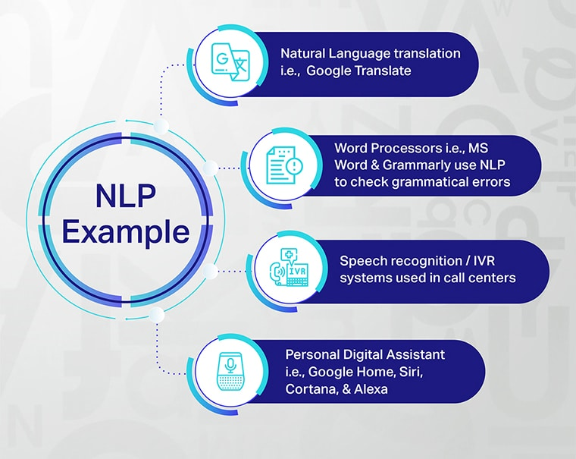

Slide 12
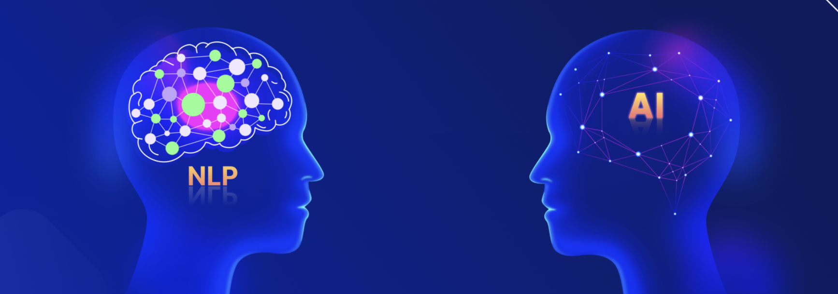

THANK YOU
OH MY GOD

